Slide 1
WLAN Security Applications Using pfSense.
A. Serdar SAHIN
Department of Software Engineering
Ankara Science University
Ankara, Turkey
s210204008@ankarabilim.edu.tr
Keywords: Legacy equipment, home lab, pfsense.

Slide 2
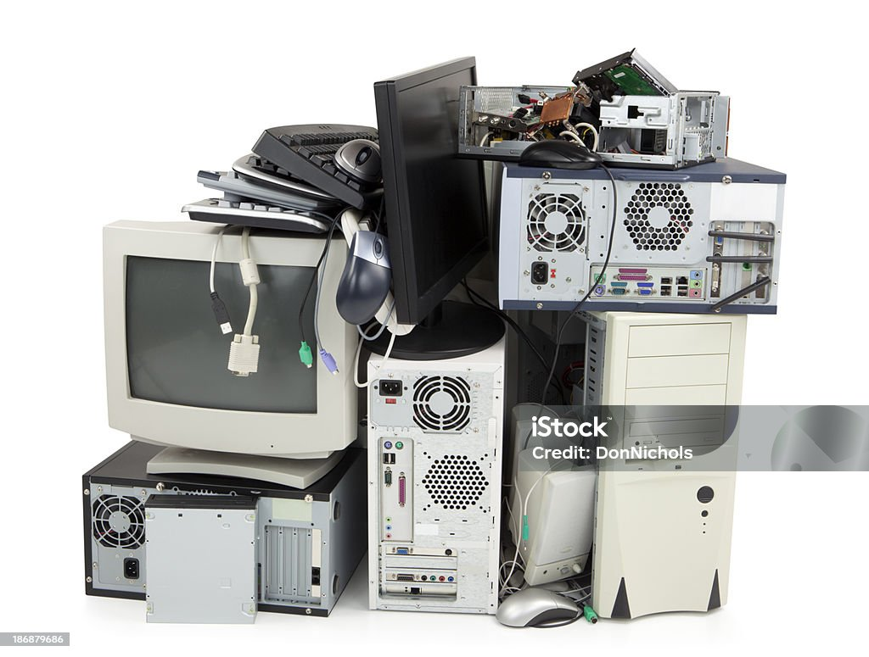
Introduction: Legacy Equipment

Slide 3
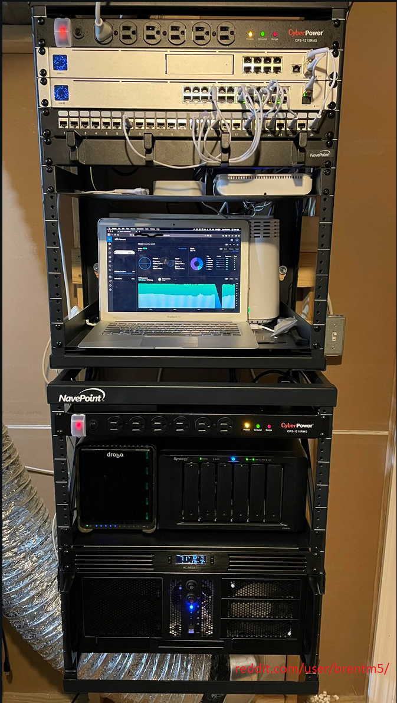
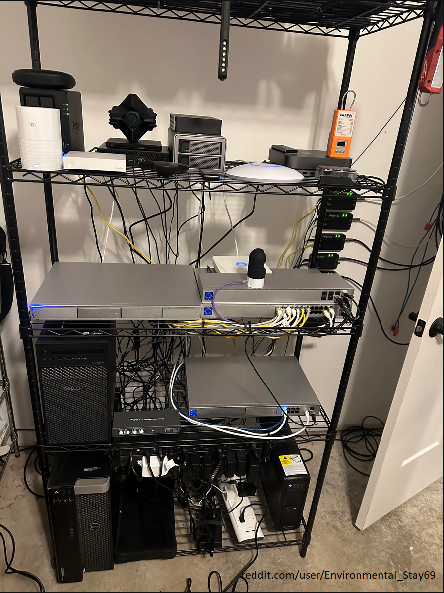
Introduction: Home Lab

Slide 4
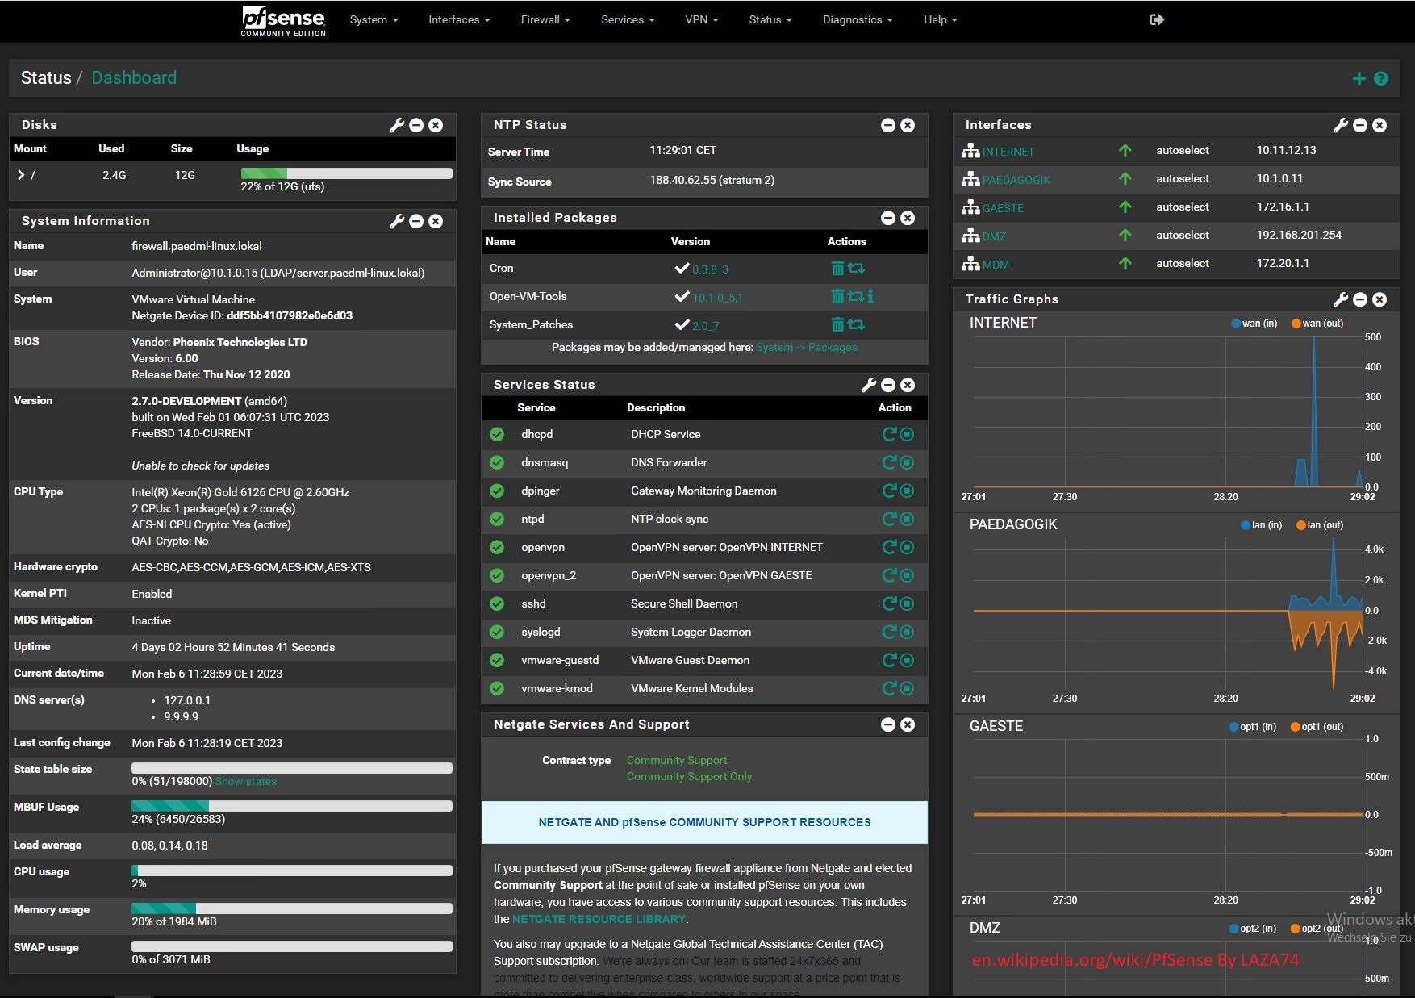
Introduction: PfSense

Slide 5
Related works
[1]M. Ellabidy, C. H. Yu, and M. Yun, “Building a Cybersecurity Lab with Legacy Equipment,” in ICERI2016 Proceedings, pp. 4407–4411, 2016, IATED
[3]Y. Maleh et al., “Building open virtual cloud lab for advanced education in networks and security,” in 2017 International Conference on Wireless Networks and Mobile Communications (WINCOM), pp. 1–6, Nov 2017.

Slide 6
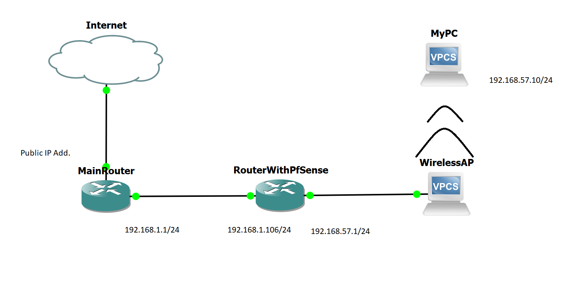
II. SYSTEM MODEL
A. Preparing the Hardware:

Slide 7
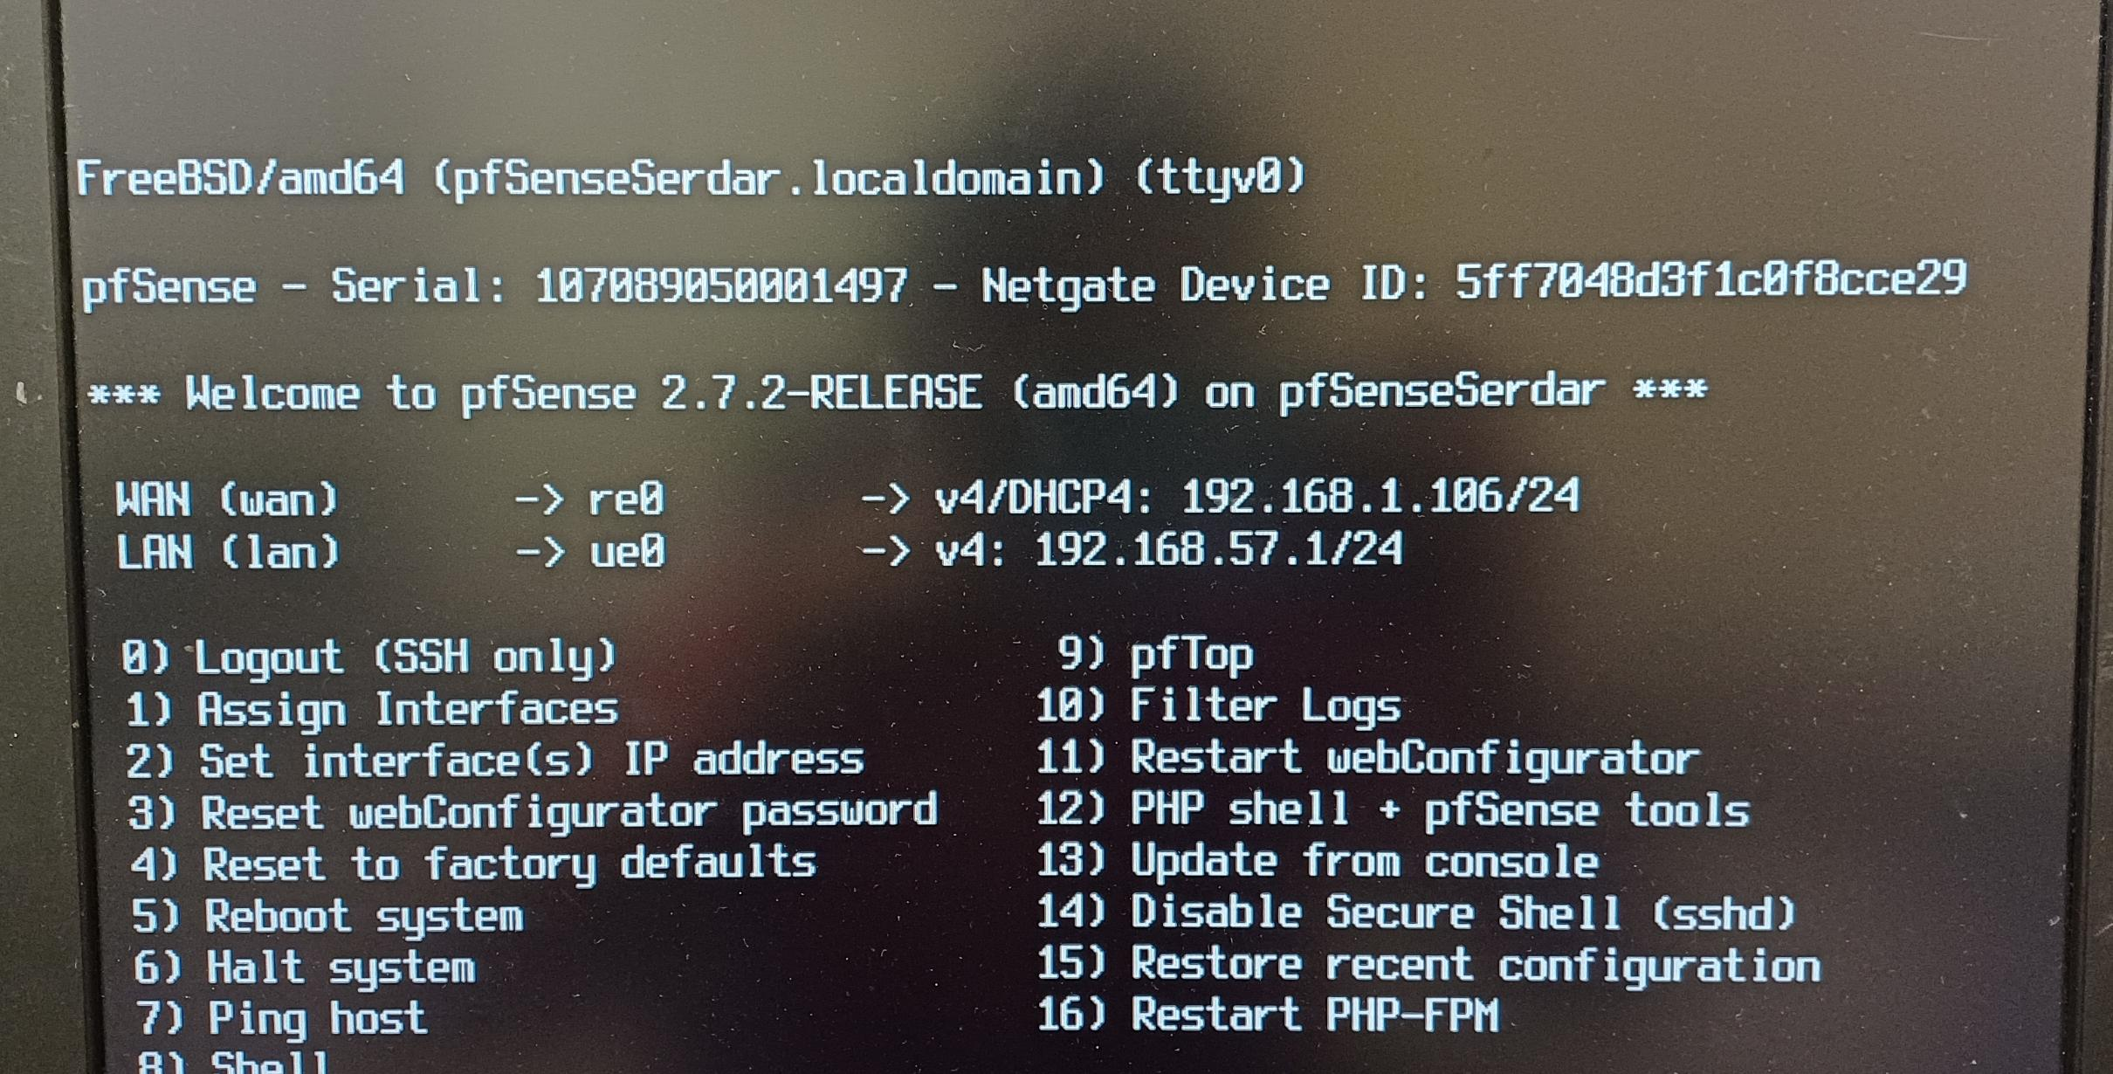
II. SYSTEM MODEL
B. Installing pfSense:

Slide 8
II. SYSTEM MODEL
C. Customization:
1) Suricata:
2) pfBlockerNG:
3) OpenVPN:

Slide 9
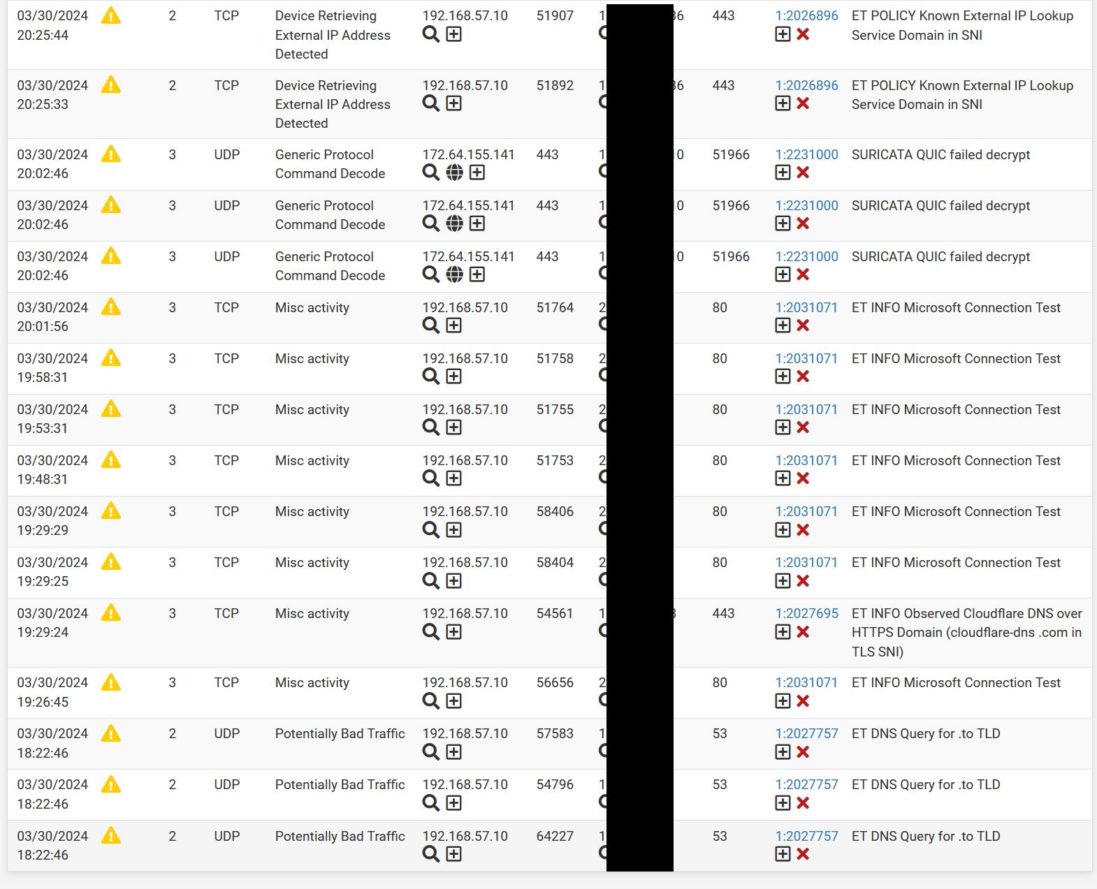
Suricata Alerts:

Slide 10
II. SYSTEM MODEL
C. Customization:
1) Suricata:
2) pfBlockerNG:
3) OpenVPN:

Slide 11
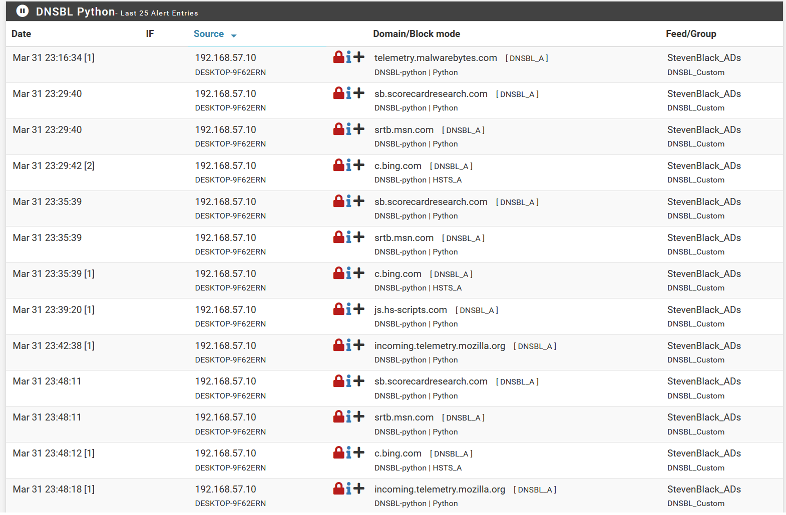
PfBlockerNG Alerts:

Slide 12
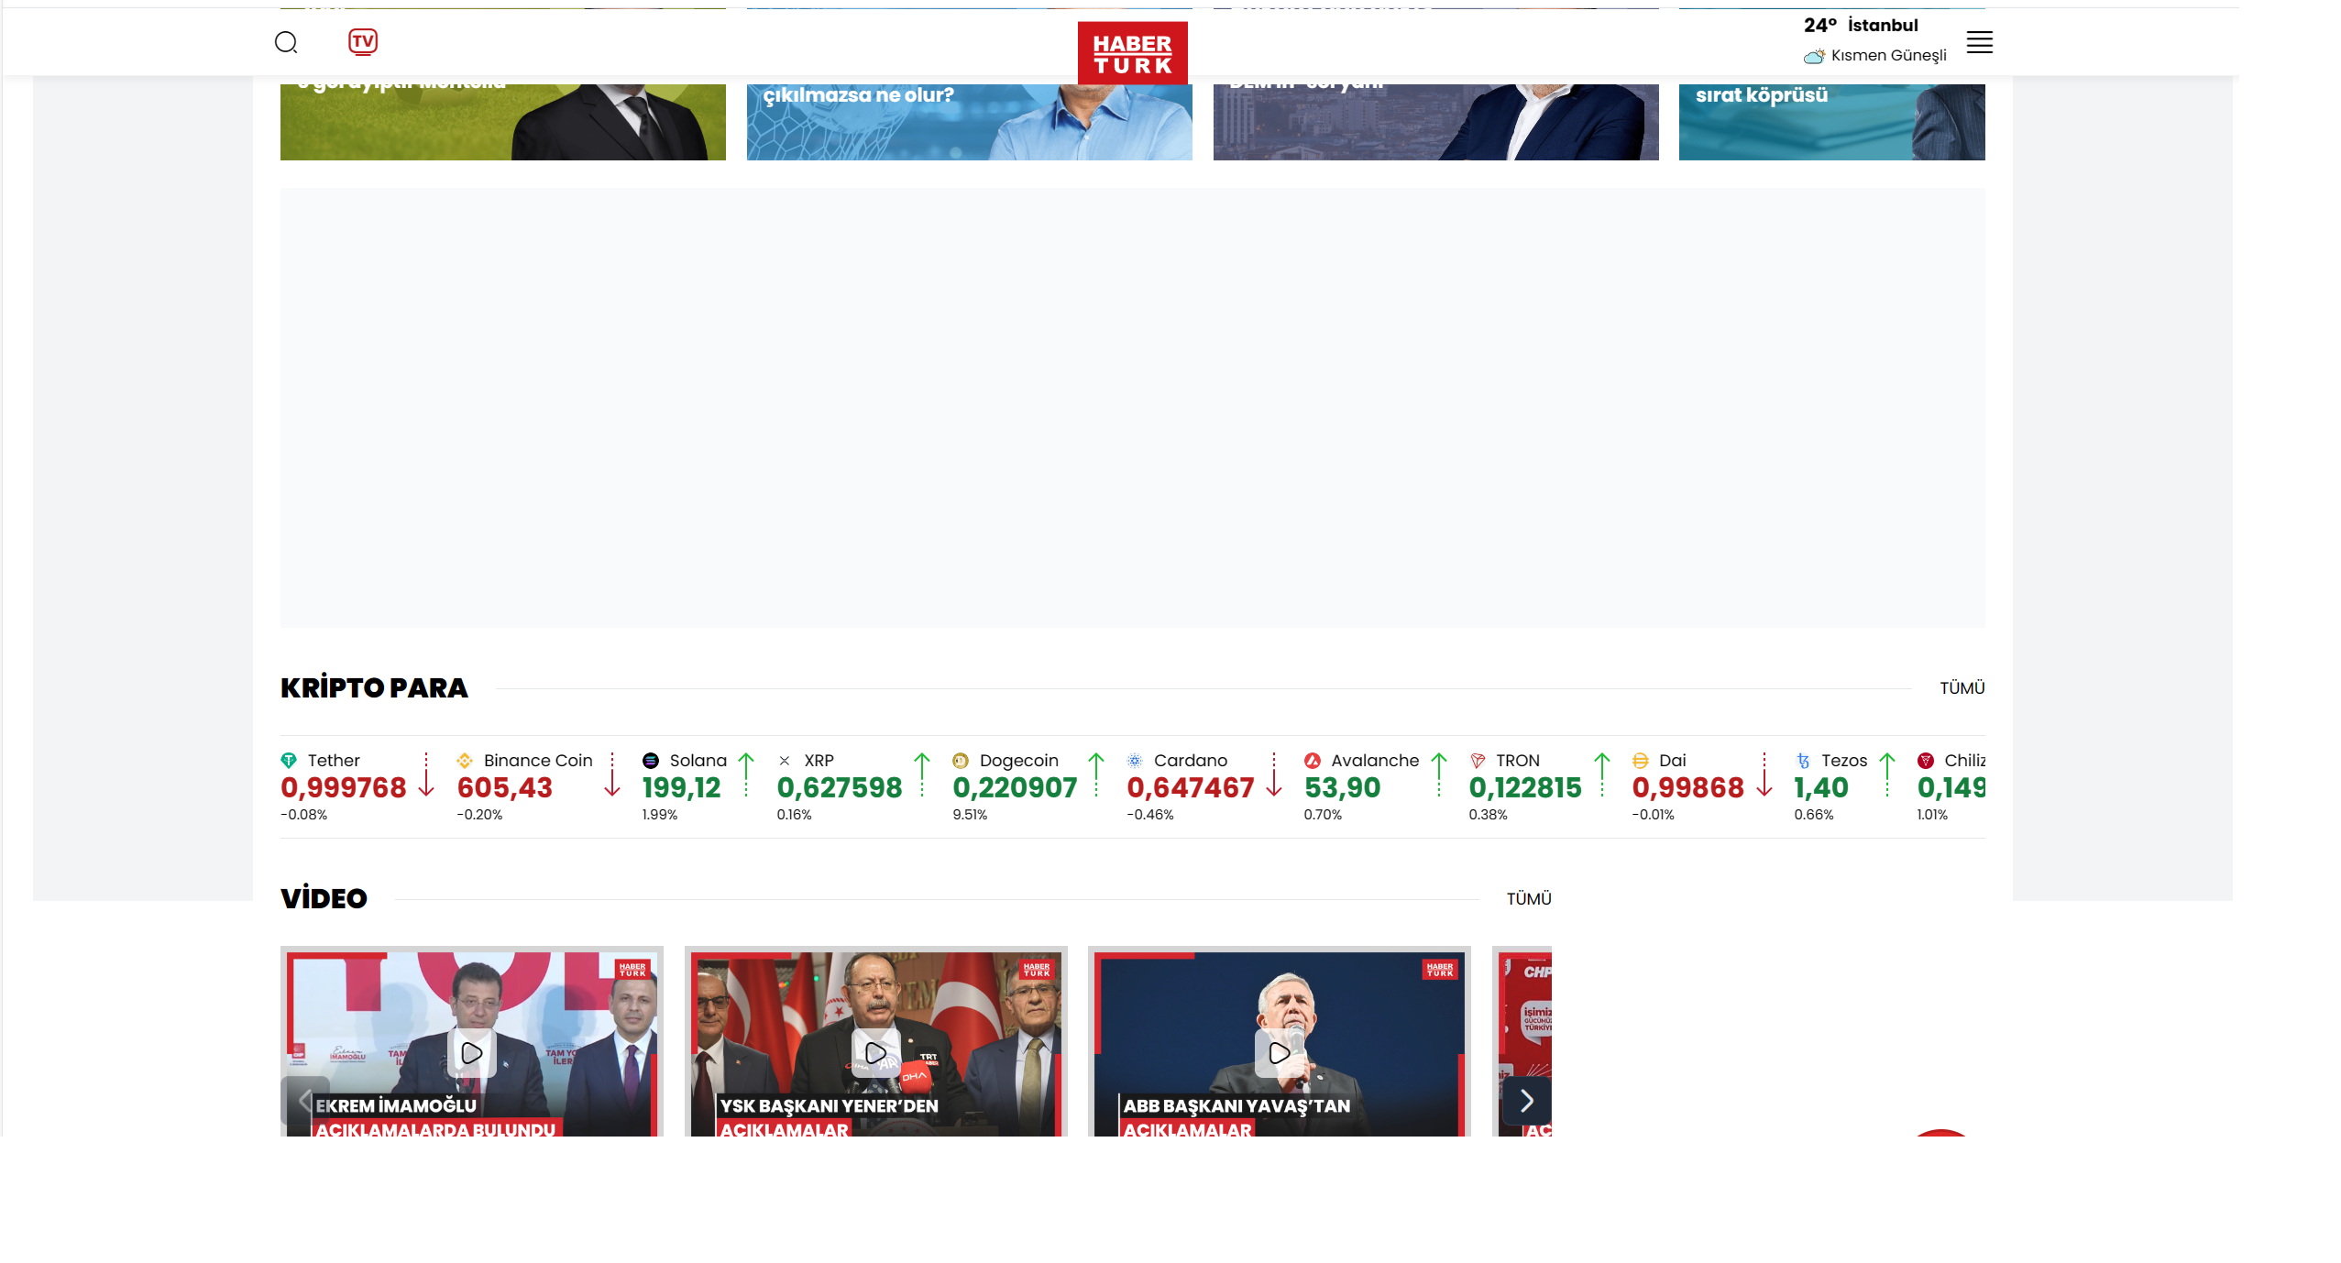
Ad Blocked Websites:

Slide 13
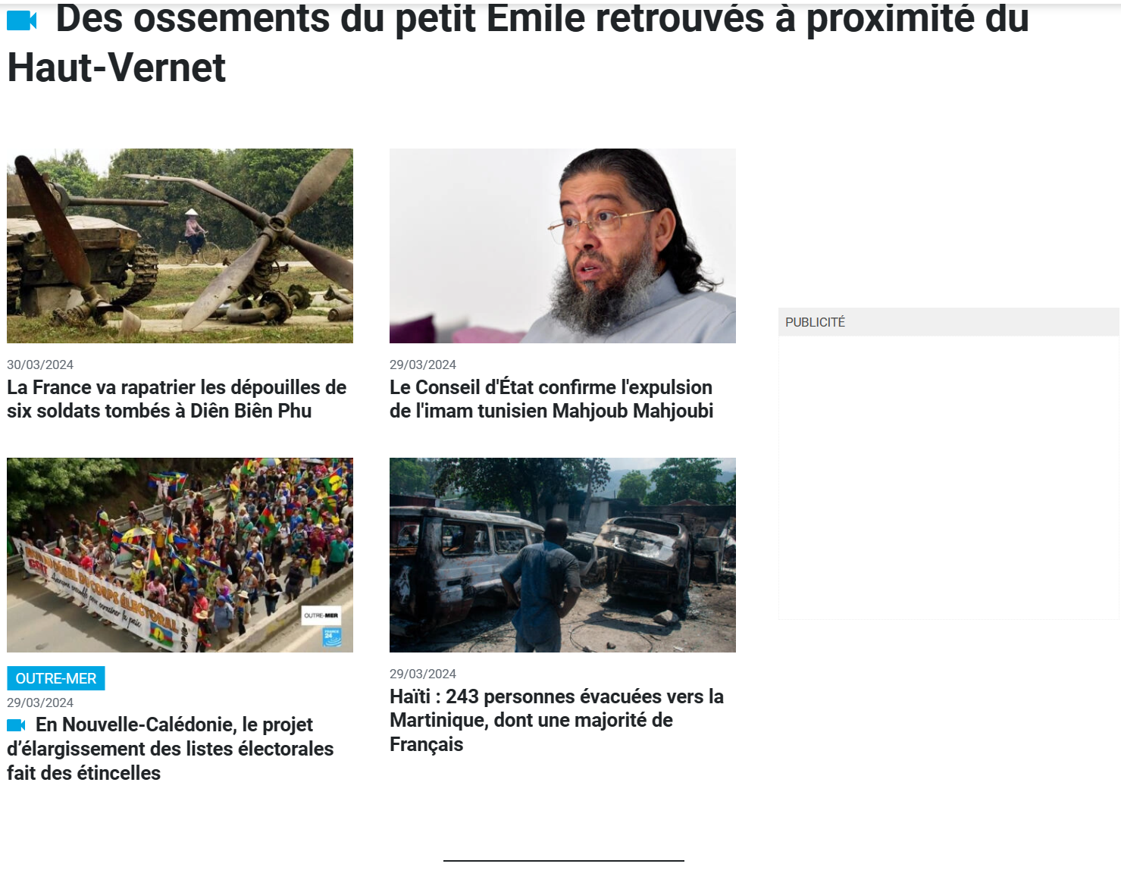
Ad Blocked Websites:

Slide 14

Blocked Website:

Slide 15
II. SYSTEM MODEL
C. Customization:
1) Suricata:
2) pfBlockerNG:
3) OpenVPN:

Slide 16
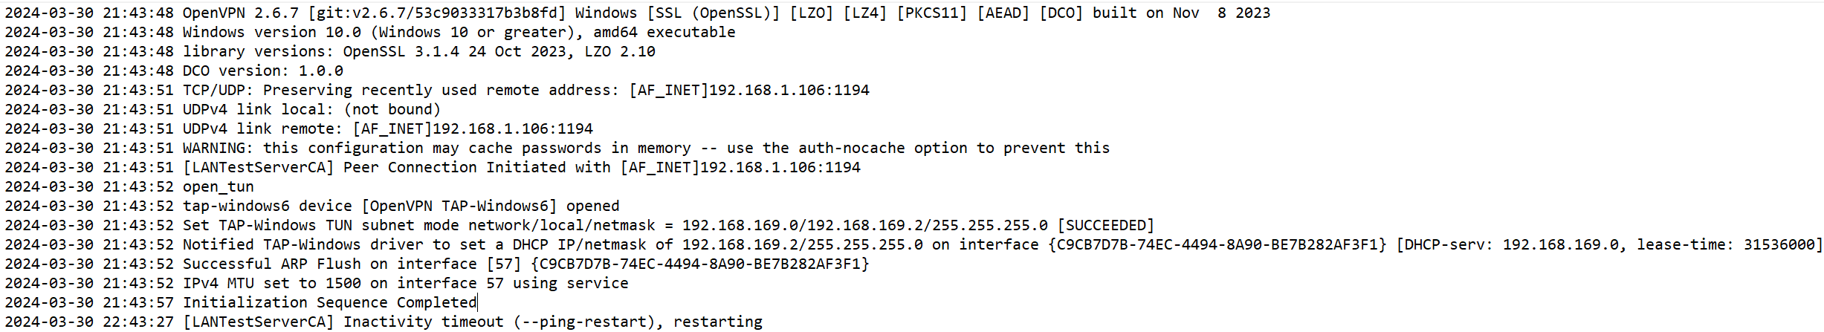
Logs From the OpenVPN Application:

Slide 17
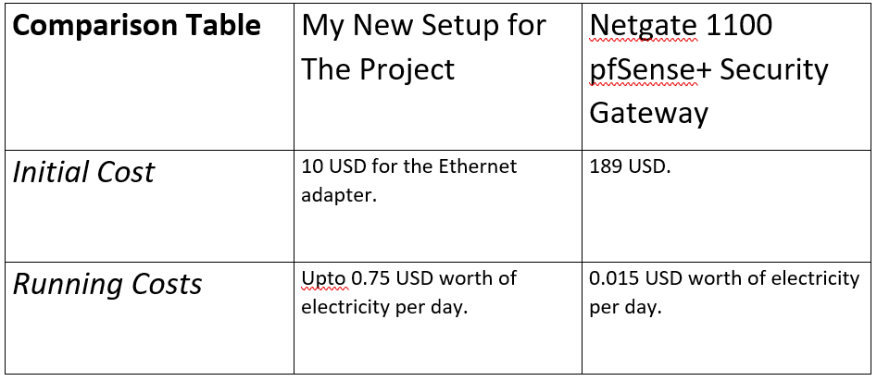
III. RESULTS
Temporarily reduced electronic waste.
Created myself a separate network, and gained experience on networking and security.

Slide 18
IV. CONCLUSIONS AND FUTURE WORKS
Both on small and larger scales, making use of legacy equipment is possible but ,especially in larger scale, hardware running costs and hardware compatibility topics should be thought about.
In the future: I would like to implement CIS guidelines. And turn this project into a proper home lab, from website hosting to a media server.

Slide 19

Questions?

Slide 20
V. ACKNOWLEDGMENT
I would like to thank my instructor Dr. Alican TOPCU for their guidance and support throughout the project.

Slide 21
REFERENCES
[1] M. Ellabidy, C. H. Yu, and M. Yun, “Building a Cybersecurity Lab with Legacy Equipment,” in ICERI2016 Proceedings, pp. 4407–4411, 2016, IATED.
[2] C. Dadiyala et al., “Designing and Implementing an Effective Cyber security Home Lab for Detection and Monitoring,” in 2023 14th In ternational Conference on Computing Communication and Networking Technologies (ICCCNT), pp. 1–8, July 2023.
[3] Y. Maleh et al., “Building open virtual cloud lab for advanced education in networks and security,” in 2017 International Conference on Wireless Networks and Mobile Communications (WINCOM), pp. 1–6, Nov 2017.
[4] C. Bae et al., “Home server for home digital service environments,” in IEEE Transactions on Consumer Electronics, vol. 49, no. 4, pp. 1129 1135, Nov 2003.
[5] B. Shamma, “Implementing CIS Critical Security Controls for Organi zations on a Low-Budget,” Ph.D. dissertation, University of Houston, 2018.
[6] Netgate, “Installing and Upgrading,” Available online: https://docs. netgate.com/pfsense/en/latest/install/index.html, Accessed: 01.04.2024.
[7] Lawrence Systems, “2020 Getting started with pfSense 2.4 Tutorial: Network Setup, VLANs, Features & Packages,” Available online: https: //www.youtube.com/watch?v=fsdm5uc LsU, Accessed: 01.04.2024.
[8] Lawrence Systems, “Setup Guide / Tutorial for pfBlockerNG 2.2.5 on pfSense with DNSBL & GeoIP Blocking,” Available online: https: //www.youtube.com/watch?v=OJ8HHwpGxHw, Accessed: 01.04.2024.
[9] Lawrence Systems, “From Ciphers to Certificates: Your Comprehensive Guide to Configuring OpenVPN on pfSense,” Available online: https: //www.youtube.com/watch?v=I61t7aoGC2Q, Accessed: 01.04.2024.
[10] Lawrence Systems, “Suricata Network IDS/IPS Installation, Setup, and How To Tune The Rules & Alerts on pfSense 2020,” Available online: https://www.youtube.com/watch?v=S0-vsjhPDN0, Ac cessed: 01.04.2024

